Slide 1
Protection And Detection Of Animals To Reduce Road Accidents
Final Year Project
Name : Durgam Shruthi (MDM18B013)
Guided by: Dr. Shahul Hamid khan

Slide 2
Problem Statement
Animals play an equal role in the survival of this ecosystem. Its security was jeopardised, leading to the extinction of wild animals.
There were once many wild animals, but they are now extinct, with only a few species left.
The vast majority of animals were killed in traffic and rail accidents.

Slide 3
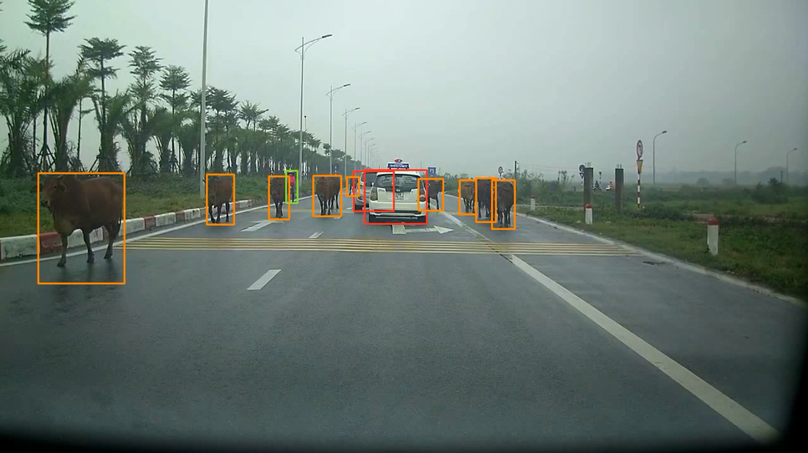
Proposed Solution
Developed an Object Detection Model to detect animals which are approaching near to the vehicles.

Slide 4
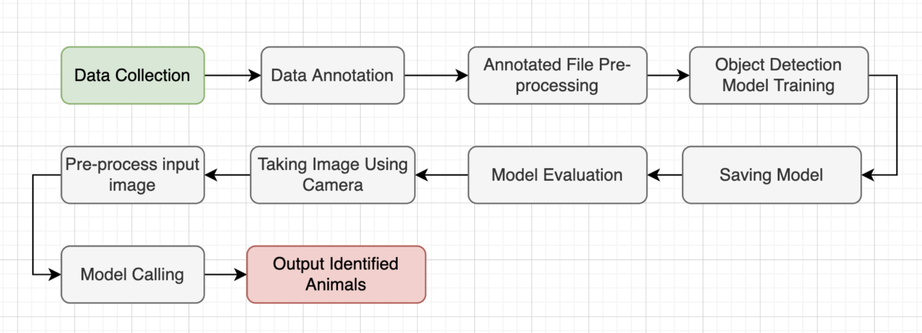
Project Architecture

Slide 5
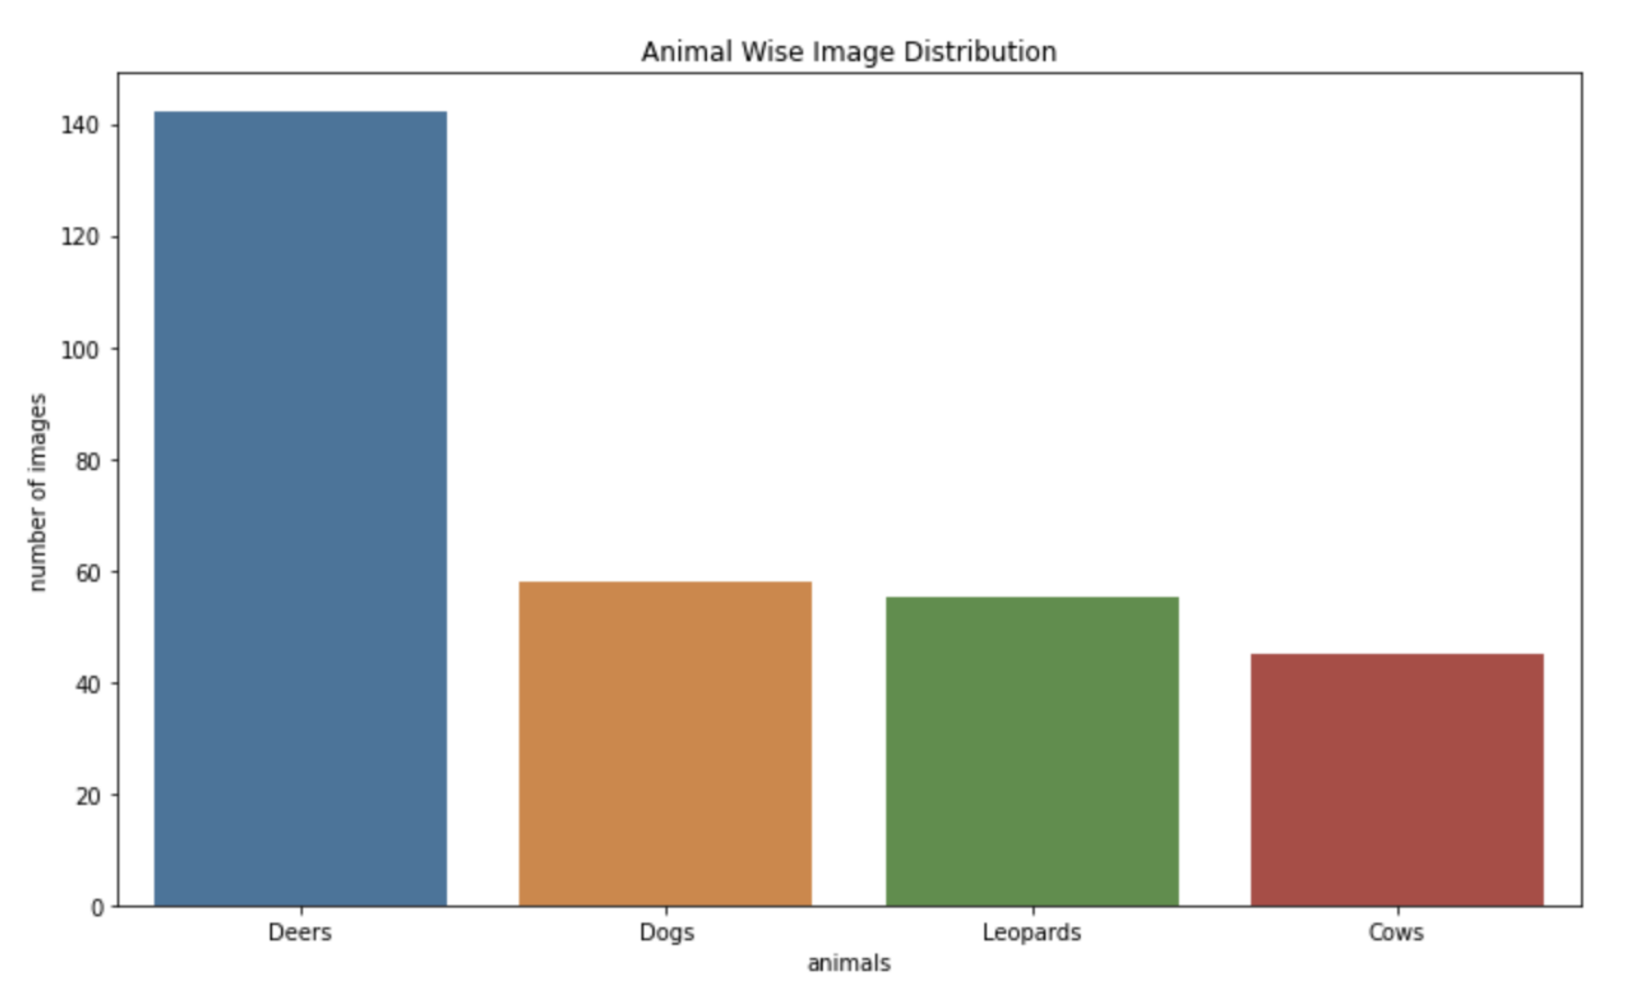
Dataset Used
Collected 300 images of various animals from the internet to train the object detection model. The animal wise image data distribution is shown below.

Slide 6
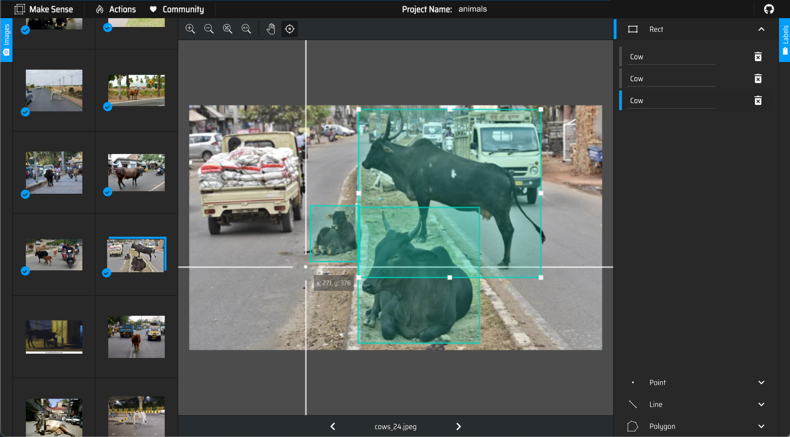
Data Annotation
Annotation is done using the makesense.ai tool. For each image, bounding boxes are drawn around the animals and their names are assigned as labels.

Slide 7
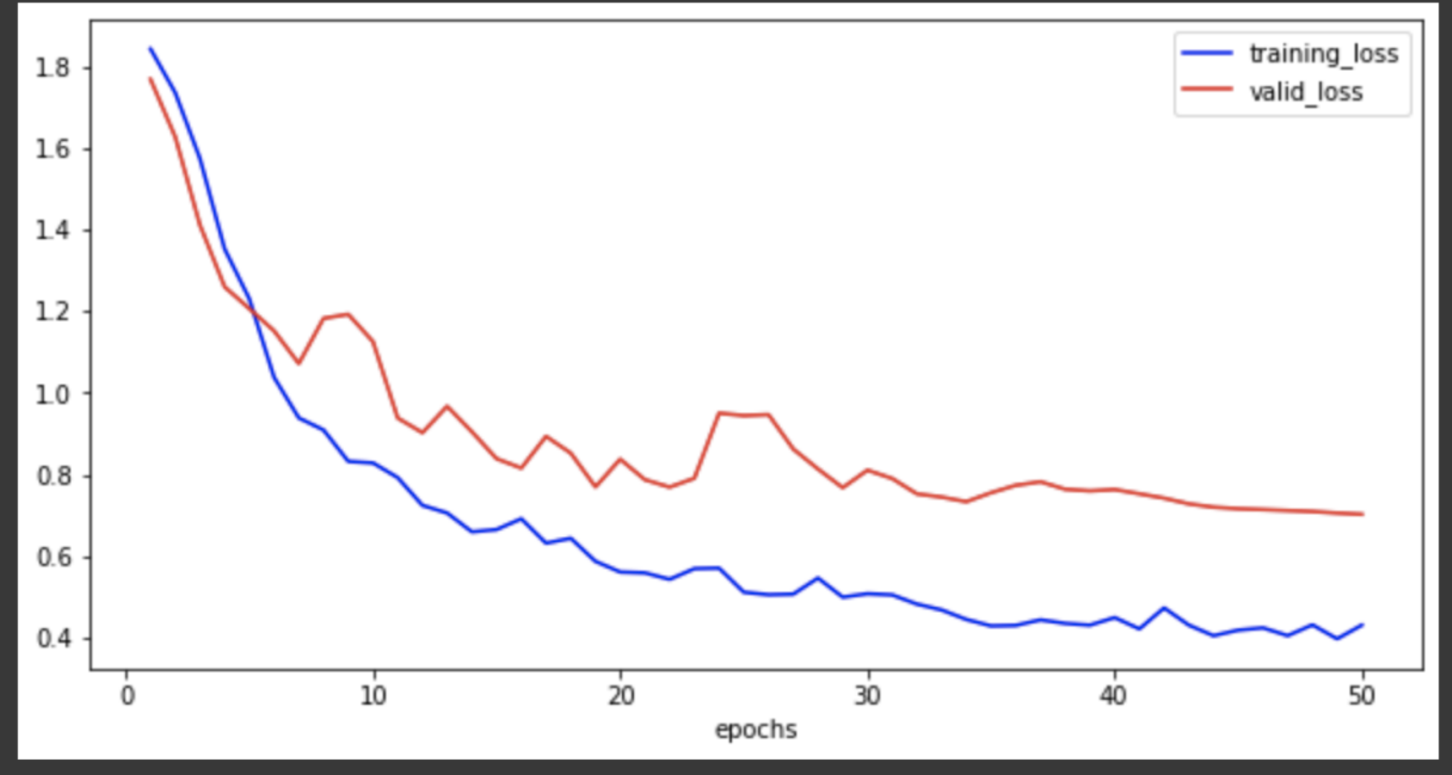
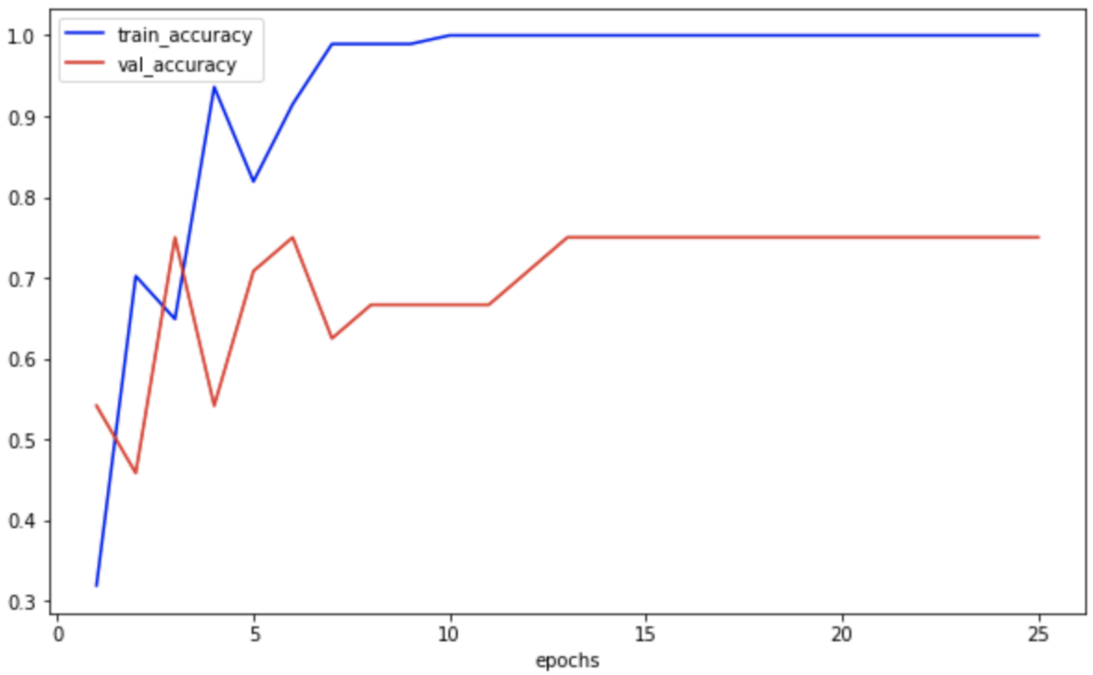
Model Training
Out of 300 animal images, 200 images are used for training the model and the remaining 100 images are used for testing.
Trained Efficient det object detection model to detect the animals.

Slide 8
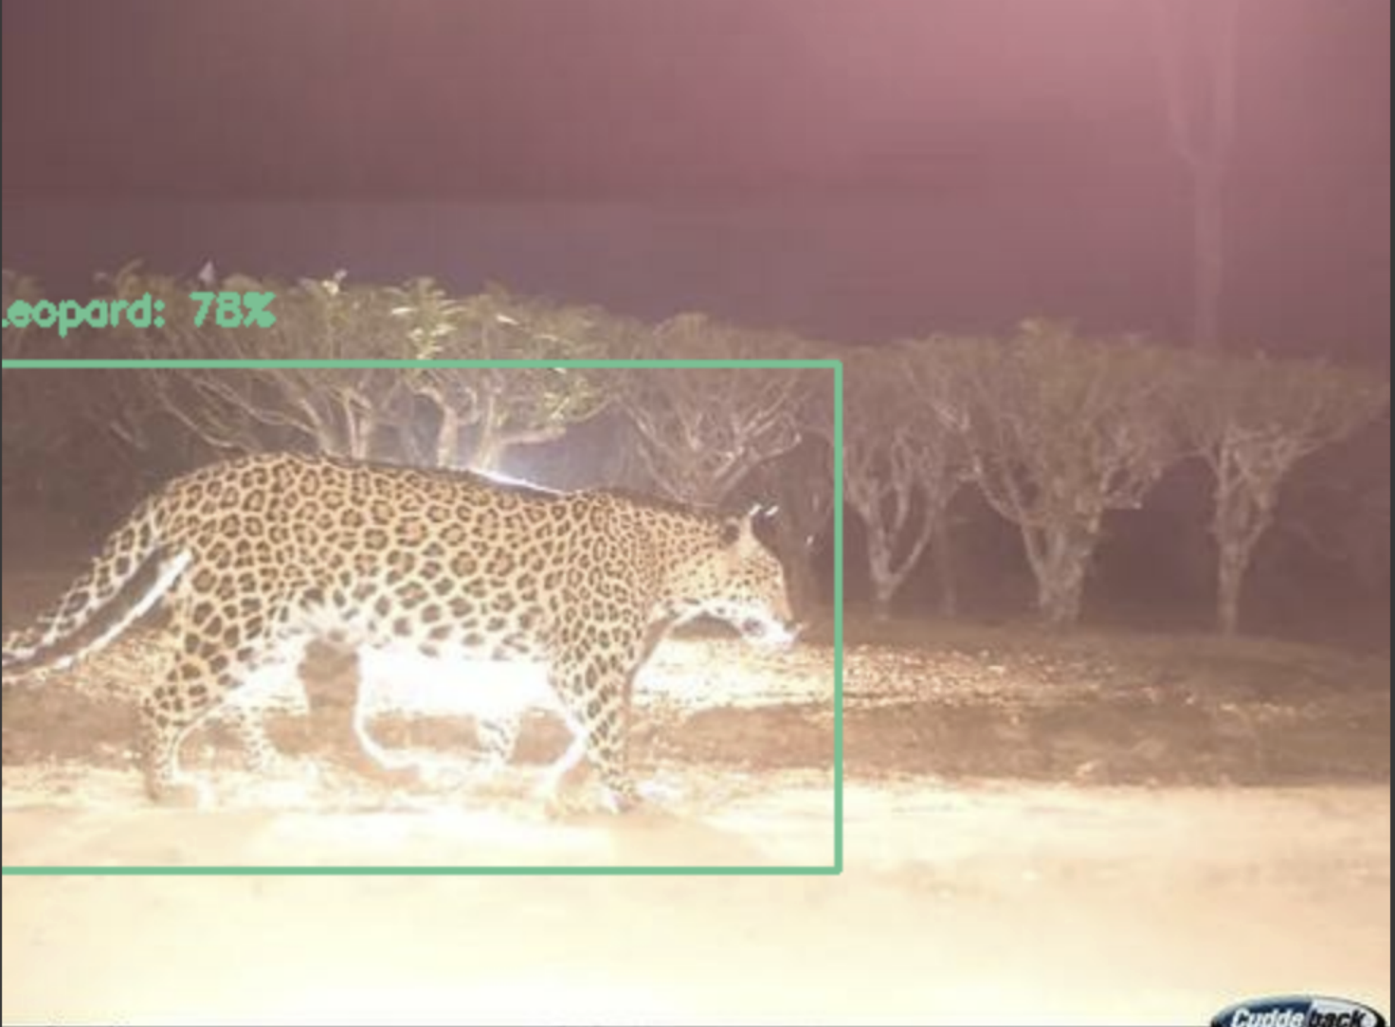
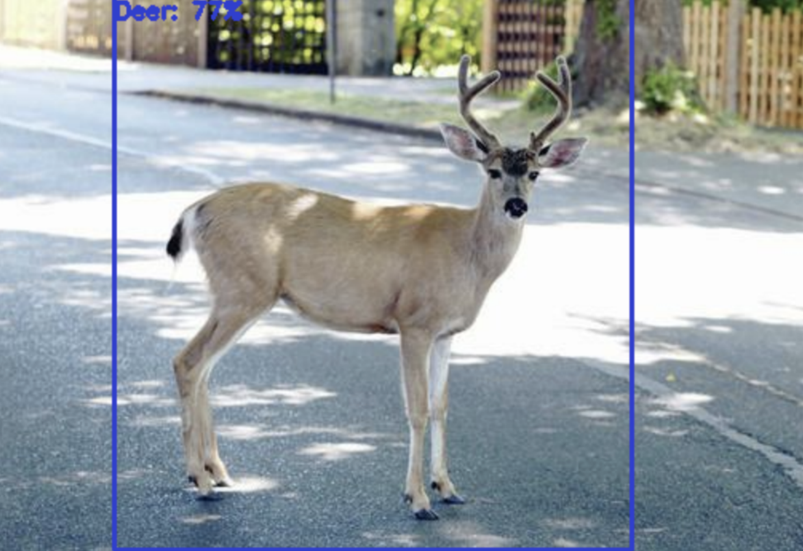
Results
The Machine Learning model achieved a training accuracy of 85% and a testing accuracy of 82%. The model is detecting Leopards and Deers well compared to Dogs and Cows.

Slide 9
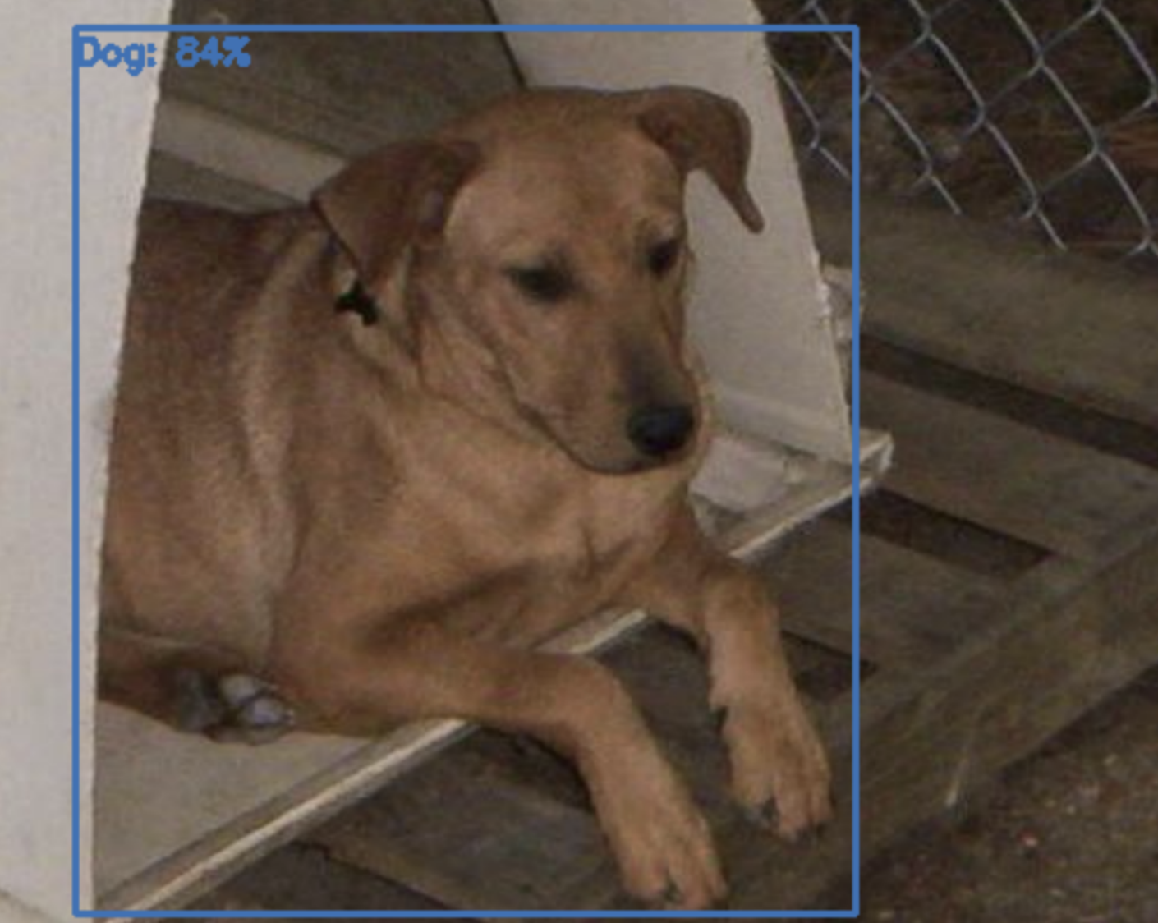
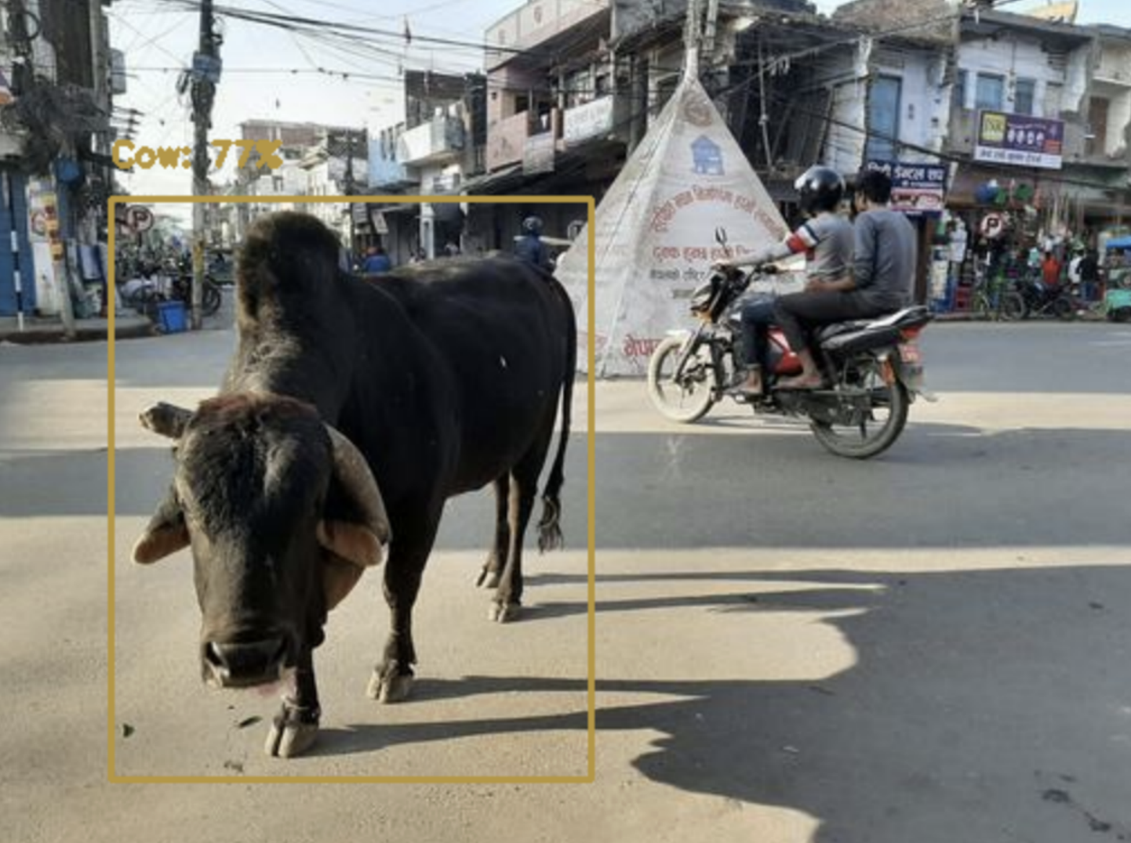
Results
The Machine Learning model achieved a training accuracy of 85% and a testing accuracy of 82%. The model is detecting Leopards and Deers well compared to Dogs and Cows.

Slide 10
Thank You
Final Year Project
Name : Durgam Shruthi
Guided by Dr.Shahul Hamid khan

